Slide 1
Python Operators and Their Applications
Name: Jayesh Bhikan Shimpi
Course: Essentials of Data Science
Class: CS1
Batch: C13
PRN: 202501040057
Purpose: Understand how Python operators help in solving programming problems.

Slide 2
Introduction to Python Operators
Python operators are symbols used to perform operations on variables and Literals which are also called as operands.
Example:
a = 10
b = 5
print(a + b)
Output: 15

Slide 3
Types of Python Operators
1. Arithmetic Operators
2. Comparison Operators
3. Logical Operators
4. Assignment Operators
5. Bitwise Operators
6. Membership Operators
7. Identity Operators

Slide 4
Arithmetic Operators
+ Addition
- Subtraction
* Multiplication
/ Division
% Modulus
** Exponent
// Floor Division
Real-life Application: Used in billing systems, scientific calculations, and data analysis.

Slide 5
Comparison Operators
== Equal to
!= Not equal to
> Greater than
< Less than
>= Greater or equal
<= Less or equal
Used in decision making systems.

Slide 6
Logical Operators
and – Outputs True if both conditions are true
or – Outputs True if at least one condition is true
not – Reverses the condition
Example: Check if a person is eligible to vote or note.

Slide 7
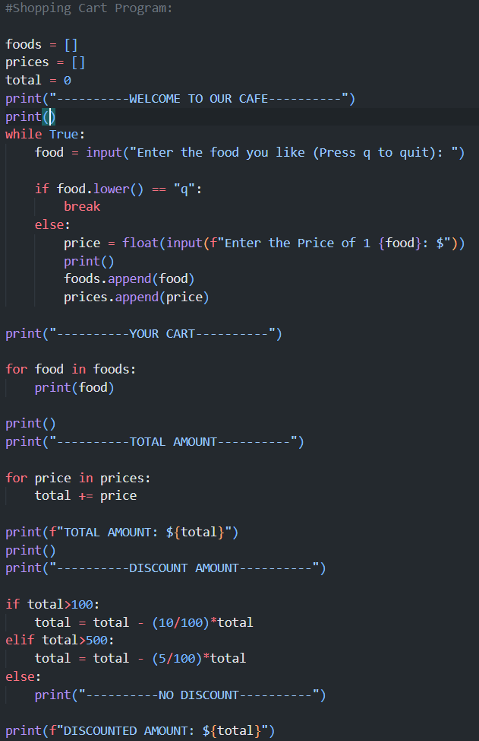
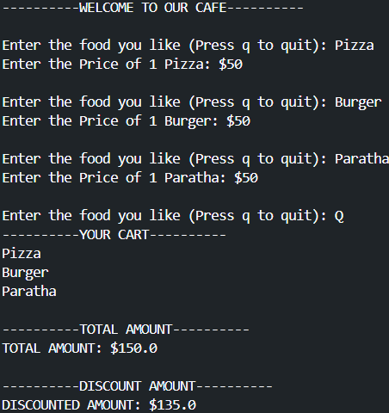
Problem Statement
Design a program that calculates discount based on bill amount.
Operators used: Arithmetic + Comparison

Slide 8
Python Implementation
price = float(input('Enter the price: '))
if total > 100:
discount = bill * 0.10
elif price > 500:
discount = bill * 0.05
else:
print(“NO DISCOUNT”)
final_amount = total – discount_amount

Slide 9
Complex Problem Solving
Student Grade System
Marks >= 90 → Grade A
Marks >= 75 → Grade B
Marks >= 50 → Grade C
Otherwise → Fail
Uses comparison and logical operators.

Slide 10
Conclusion
Python operators are fundamental for programming.
They help perform calculations, comparisons, and logical decisions.
Understanding operators improves problem-solving skills in software development.

